Slide 1


University of Milano-Bicocca
Master Degree in Data Science
Accademic Year 23/24
Social Media Analytics
Authors:
FEDERICO BIDONE, PAOLA MARIA CAVANA

Slide 2

Introduction
Dataset
The project aims to examine the comments and communities of the subreddit r/politics over the period from 2007 to 2022.
r/politics is the main subreddit for global political discussion, with a predominant focus on American politics.

Slide 3




Objective
Dataset
Identifying predominant figures over time
Assessing emotional trends
Understanding the polarization over the years
Detecting the presence of distinct communities

Slide 4




Data Collection
Preprocessing
Pipeline
Social Network Analysis
Social content analysis

Slide 5
Data Collection
Dataset
First idea: use of Reddit’s API

Slide 6
Data Collection
Dataset
First idea: use of Reddit’s API
Second idea: Pushshift Dump

Slide 7
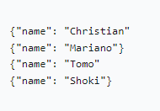
Preprocessing
Dataset
Dealing with 172GB of raw data
NDJSON data structure:

Slide 8
Preprocessing
Dataset
Extracting and Filtering Data
Reads Zstandard-compressed JSON file.
Implements a chunk-based approach for processing large files.
Filters comments based on specified date range (2007-2022).
Extracts specified fields from each JSON object.
Writes data to a CSV file for each year in the range.

Slide 9
Preprocessing
Dataset
Performing Sentiment Analysis:
Utilizes VADER from NLTK for sentiment analysis.
Analyzes sentiment of each comment.
Adds sentiment scores (positive, negative, neutral) to the DataFrame.

Slide 10
Building Network Graphs
Dataset
Create dataframes that represent the connections between the various comment authors grouping data by authors and parent authors.
Calculates interaction count and average sentiment.
Constructs directed graphs representing interactions.
Saves graphs for each year in the specified range.

Slide 11
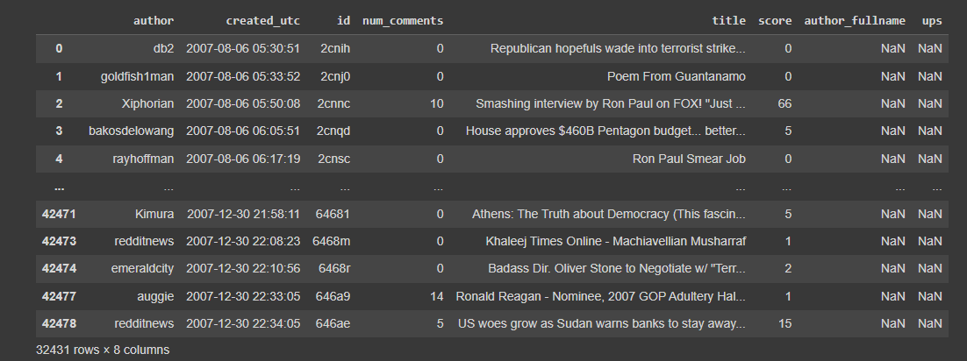
Data Exploration
Dataset
politics_submissions_YYYY contains all posts from the r/politics subreddit from that year.

Slide 12
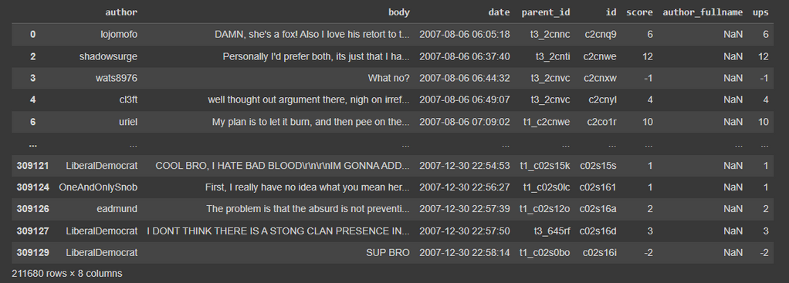
Data Exploration
Dataset
politics_comments _YYYY contains all comments from the r/politics subreddit from that year.

Slide 13
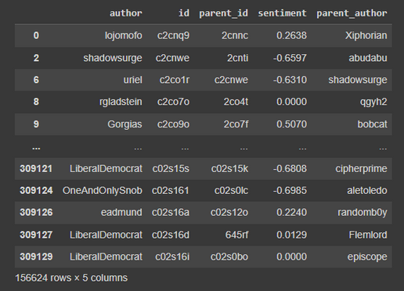
Data Exploration
Dataset
connections_YYY contains the connections of each comment with its parent. The columns are:
author: nickname of the comment author
id: id of the comment
parent_id: id of the parent (comment or post)
sentiment: Overall sentiment value of the comment text, between -1 and 1.
parent_author: nickname of the parent author (comment or post)

Slide 14
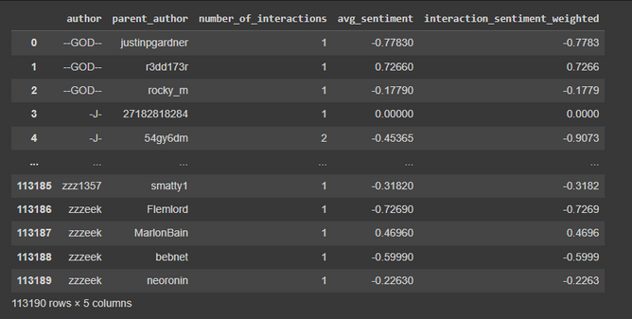
Data Exploration
Dataset
groupby_connections_YYY contains the connections of each comment with its parent grouped by author, the purpose is to represent the link between all comment authors. The columns are:
author: nickname of the comment author (sender)
parent_author: nickname of the parent's author (recipient)
number_of_interactions: number of comments that sender sent to that recipient
avg_sentiment: Average sentiment of comments
interaction_sentiment_weighted: number_of_interactions*avg_sentiment

Slide 15
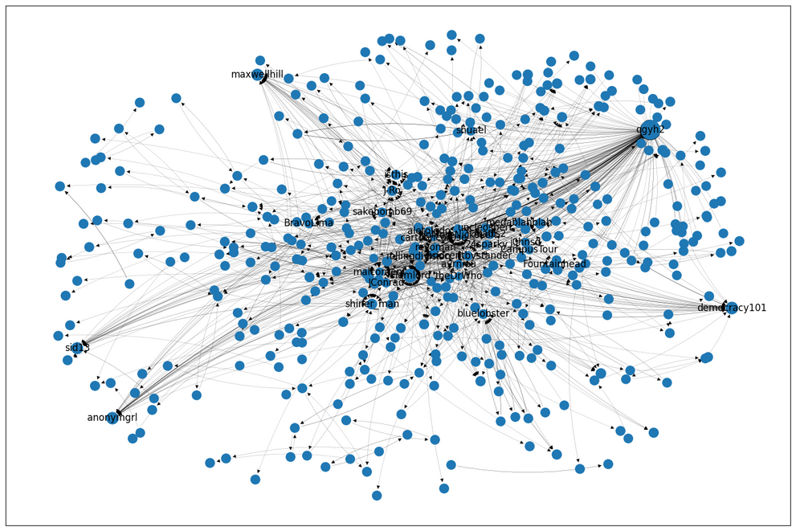
Data Exploration
Dataset
Top 1000 authors graph

Slide 16


Computational Constraints
Dataset
Limited computational capacity for analyzing graphs spanning 2007 to 2022.
Implementing a function that prioritizes the most connected components, narrowing the analysis down to 10,000 nodes.
Despite this, the analysis aims for meaningful insights without compromising integrity.

Slide 17
Social Network Analysis
Dataset
For each obtained graph, we calculated the following parameters:
Number of nodes
Number of edges
Assortativity
Node connectivity
Edge connectivity
Graph density
Overall reciprocity
Number of strongly connected component
Average degree

Slide 18
Social Network Analysis
Dataset
Given the nature of graphs, we calculated also these metrics centrality:
Degree Centrality
Closeness Centrality
Betweenness Centrality
Then we obtained the top 10 values for each mentioned centrality metrics in all graphs.

Slide 19
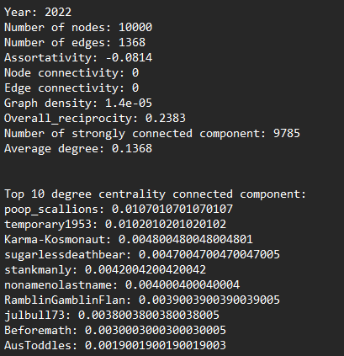
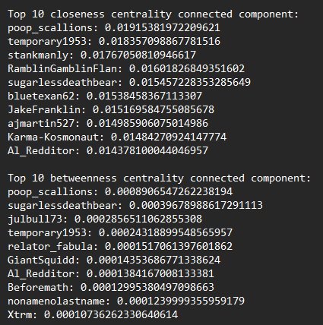
Social Network Analysis
Dataset

Slide 20
Community Detection
Dataset
The identification of communities in graphs was achieved through the use of the Clauset-Newman-Moore greedy modularity maximization algorithm.
For the visualization of the communities we used two libraries:
networkx
pyvis
Then, we calculated the modularity score for each community structures and extracted the three main communities within each graph based on their modularity scores.

Slide 21
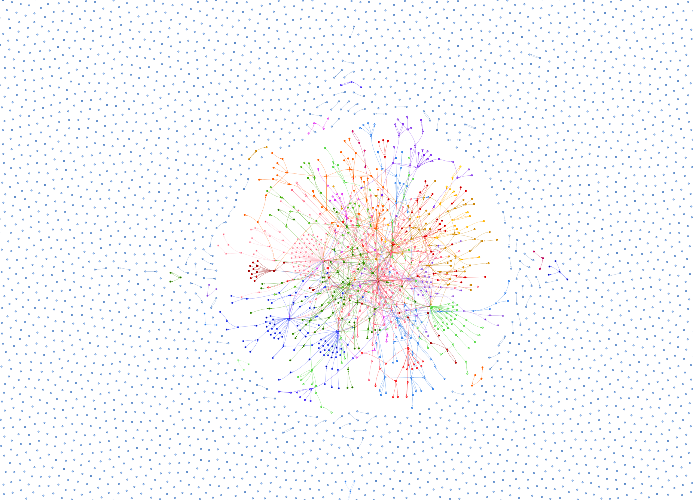
Community Detection
2022

Slide 22
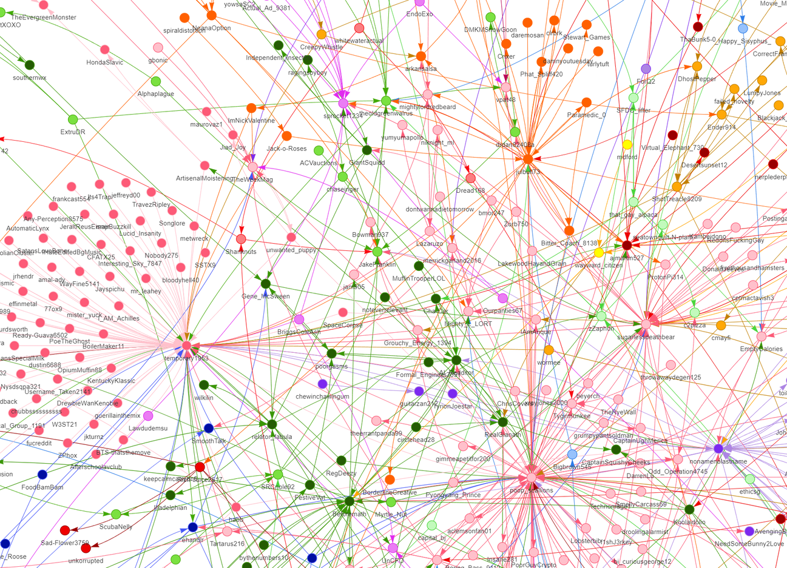
Community Detection
Dataset

Slide 23



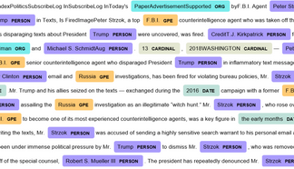
Social Content Analysis
Dataset
Keywords analysis
Polarization assessment
Emotion detection
Named Entity Recognition

Slide 24

Computational Constraints
Dataset
Limited computational capacity for analyzing comments dataframe spanning 2007 to 2022.
Implementing a function that takes the first 1 million comments with the highest score from the dataframe
score: upvote - downvote

Slide 25
Keywords
Dataset
For the keyword extraction phase, we implemented a function that:
Remove special characters from the text
Tokenize the text using “word_tokenize”
Performe Part-of-Speech tagging using the “pos_tag” function
Extracte keywords, with a specific focus on noun (N) or adjectives (J)
For the visualization of the keywords we have chosen the word cloud.
Finally, we presented the twenty most frequently used keywords within a specific year.

Slide 26
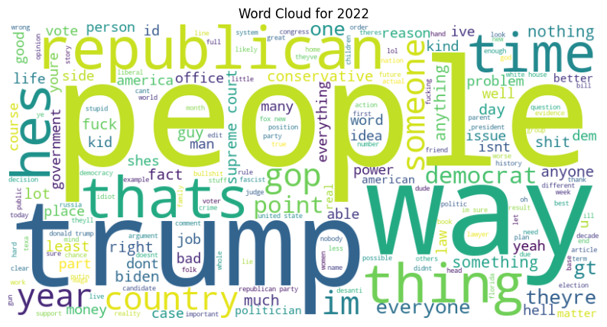
Keywords
Dataset

Slide 27
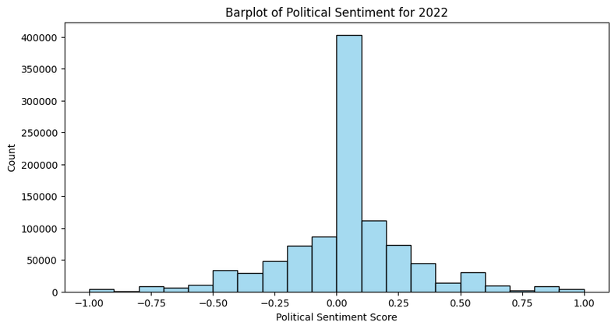
Polarization
Dataset
Analyzing sentiment polarity was conducted using TextBlob, a Python library for NLP tasks.
The distribution of sentiment polarity results is visually represented through the implementation of a bar plot.

Slide 28
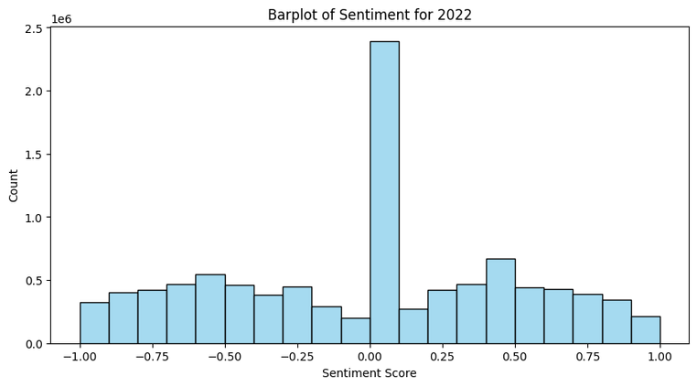
Polarization
Dataset
We had concerns that TextBlob, in our case, might not be the most suitable library for polarization analysis, prompting us to conduct a verification using VADER.

Slide 29
Emotion Recognition
Dataset
For the Emotion Recognition we use the NRCLex library.
The NRC Emotion Lexicon is a list of English words and their associations with eight basic emotions (anger, fear, anticipation, trust, surprise, sadness, joy, and disgust) and two sentiments (negative and positive).
For each graph we get the frequencies of each emotion and the top emotions. Then we added two different visualization:
table (a column for emotions and a column for the absolute frequencies of each emotion)
pie chart

Slide 30
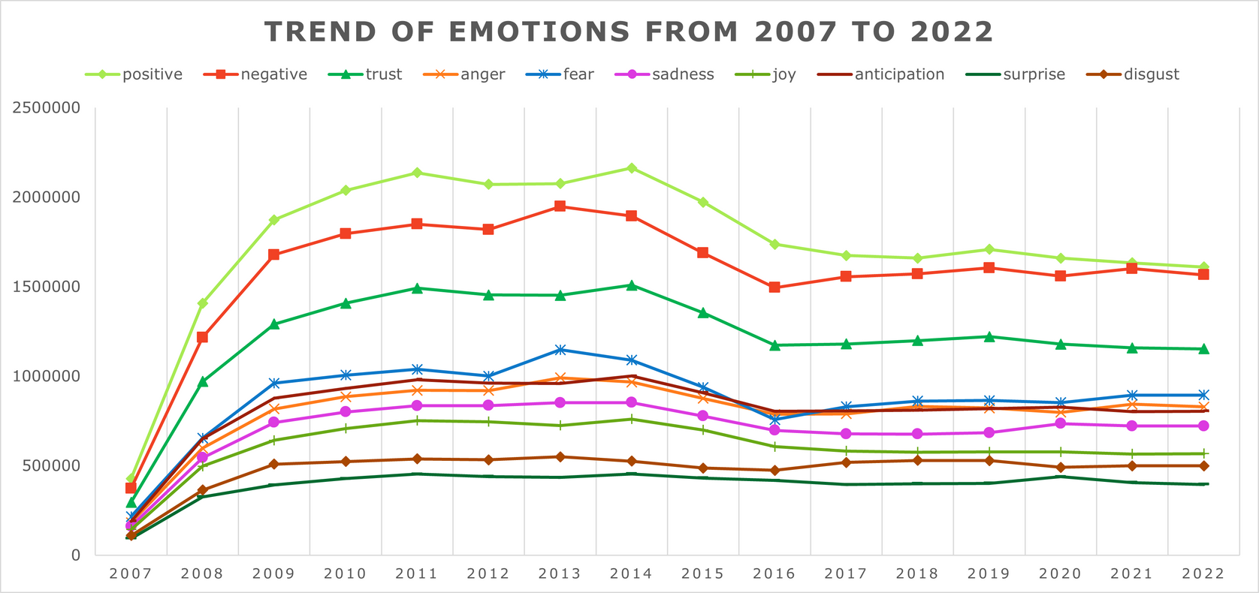
Emotion Recognition
Dataset

Slide 31
NER
Dataset
Named Entity Recognition (NER) was employed on our dataset to identify and extract proper nouns and organizational names.
The NER process was executed using spaCy.
Finally we implemented two visualizations:
Bar Plot
Word Cloud

Slide 32
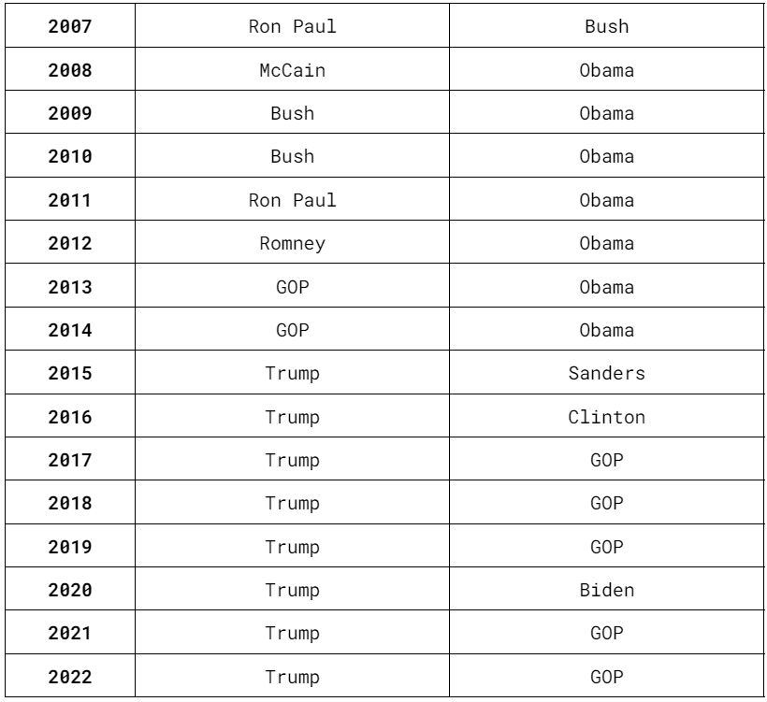
NER
NER

Slide 33

Identifying predominant figures over time
Assessing emotional trends
Conclusion
Understanding the polarization over the years
Detecting the presence of distinct communities

Slide 34
THANK YOU FOR YOUR ATTENTION!

